Slide 1

Development of MCQ System
Module : Programming Foundations
Learner Name : Ida Bagus Ketut Yoghantara
Class : BDSE04-0322

Slide 2

Document History
Version Number | Effective Date of release | Summary of Included Changes | Author
1 | 1 Jul 21 | First Edition | Jeyashree
2

Slide 3
Contents
Project Definition
Project Deliverables
Project Milestones & Tasks
Project Environment
Tools
Project Design
Classes & Methods
Steps from Coding to Execution
Development Process
Coding Standards
Milestone Feedback & Action Taken
Project Results
Proposed Improvements

Slide 4
1. Project Definition
Project Objective
To developed working MCQ System application
Test and validate to meet the project requirement
To creating a report
To creating Presentation
Proposed Solution
Build the algorithm and design the flow chart
Developed the MCQ project in IntelliJ IDEA
Test and debug the application to fix any error
Produce Project Report and Project Presentation

Slide 5



2. Project Deliverables
Project Deliverables
Source code for the working MCQ System
MCQ Set (CSV Files)
Project Report
Project Presentation
List of Evidences
Screenshots of the project directory

Slide 6
3. Project Milestones & Tasks
Project Task ID | Project Task Description | Project Milestone ID
1 | Create Requirement Specification | 1
2 | Develop Algorithm | 1
3 | Analysis and Design | 2
4 | Create the Application | 2
5 | Test the Application | 3

Slide 7
4. Project Environment
Technical Environment and Tools Used
Java JDK 17
IntelliJ IDEA
draw.io
Microsoft Word
Microsoft Power Point
List of references
Linkedin.com/learning
W3school.com
Geeksforgeeks.org
Javatpoint.com
Stack overflow
Quizizz.com
Developer.com

Slide 8
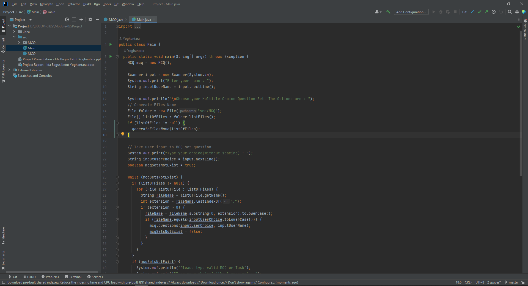
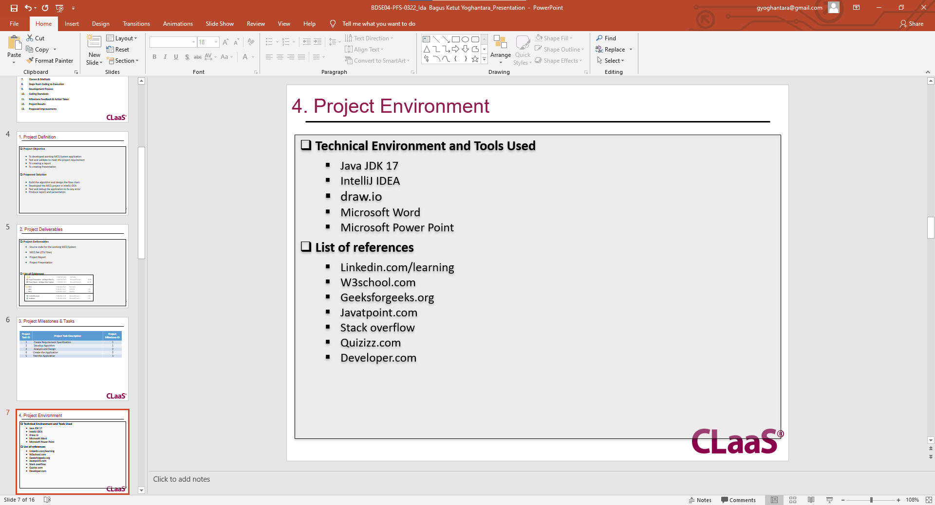
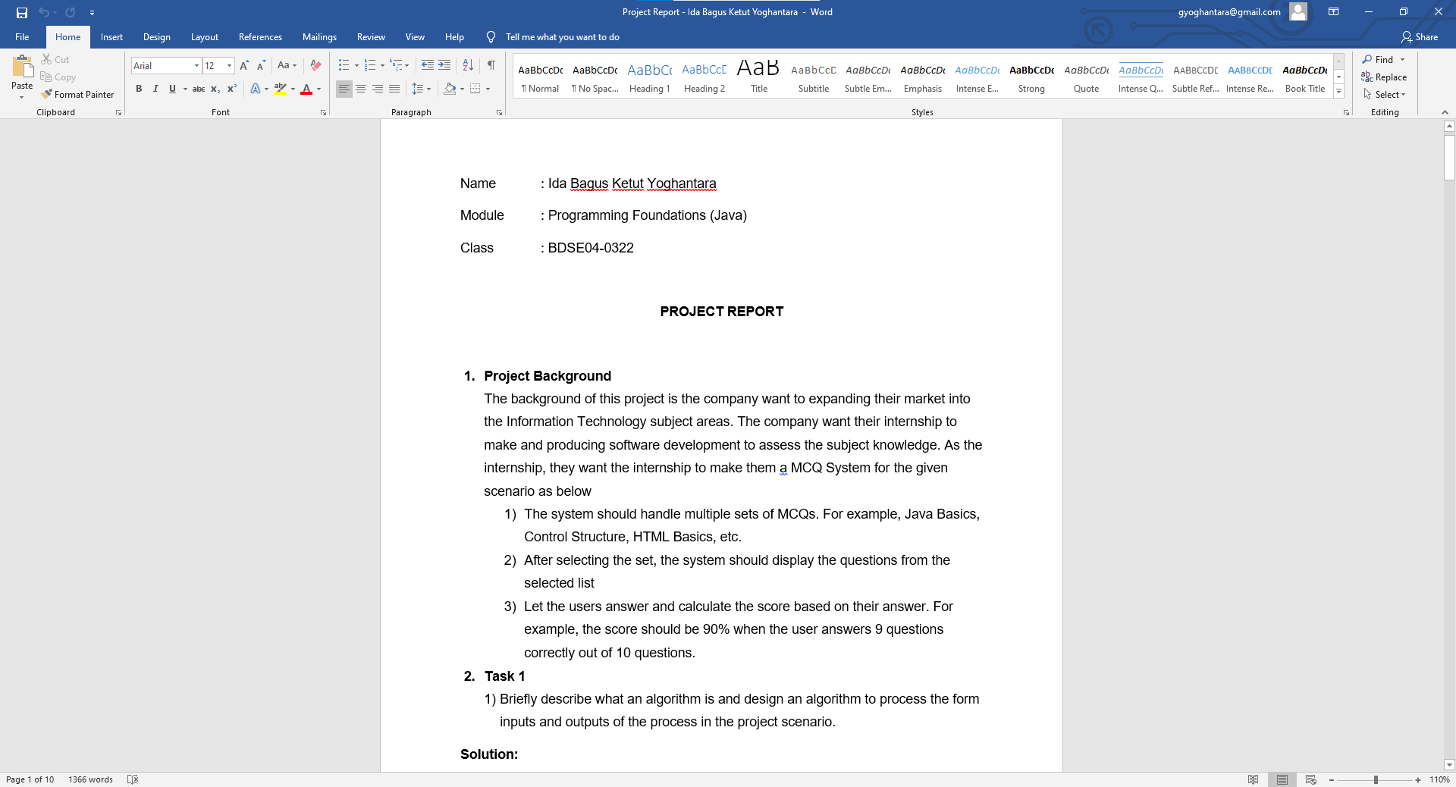
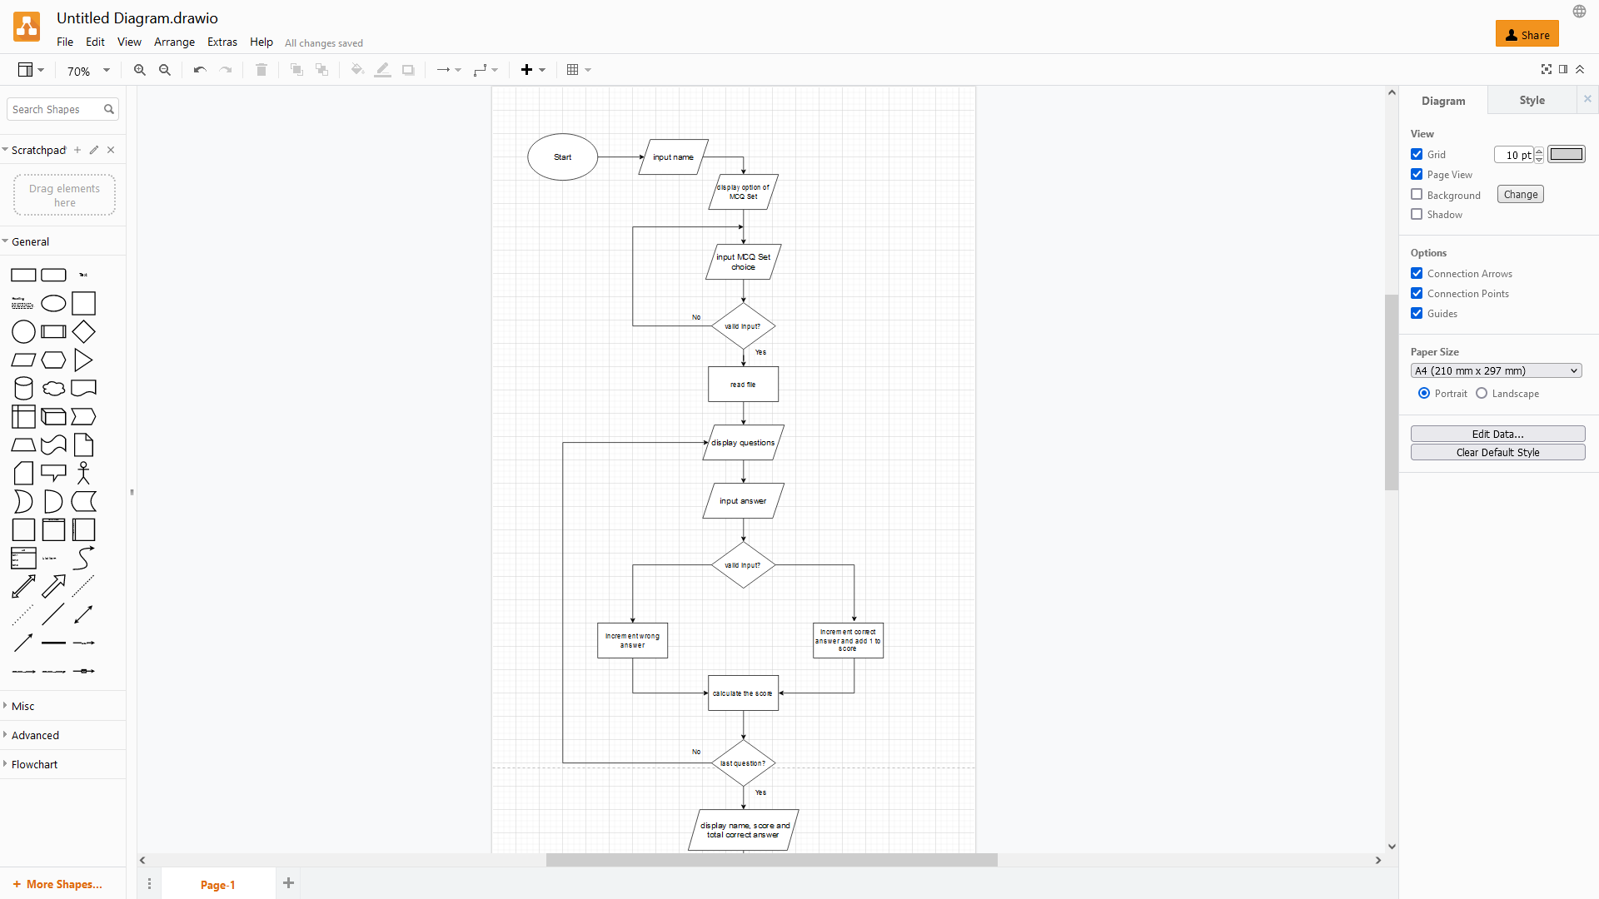
5. Tools
Screen capture of various tools used

Slide 9
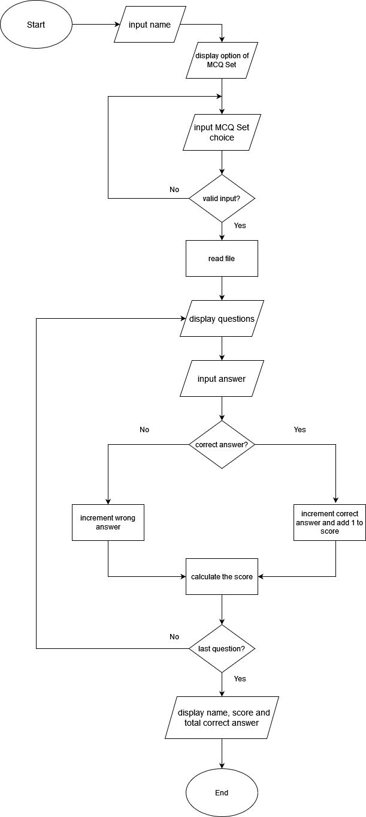
6. Project Design
System Design

Slide 10
7. Classes & Methods
List of Classes & Methods used
Main class
MCQ class
generateFilesName (method)
Questions (method)

Slide 11
8. Steps from Coding to Execution
Application execution methods
Defining the problem
Before writing the code it’s better to know what are the problem first. In this project of developing a MCQ System, there are some problem that can be defined like: - What should we use to take user input from console - How to read and display the CSV file from java program - How to validate user input - How to make the score when the user answering the MCQ
Planning the solution
After we defining the problem, the next step is planning the solution. These are the solution for given problem above: - Using Scanner to take user input from console - Reading the CSV file using FileReader - Using if-else statement and loop to validate the user input - Using variable score and add the score when the user answer correctly

Slide 12

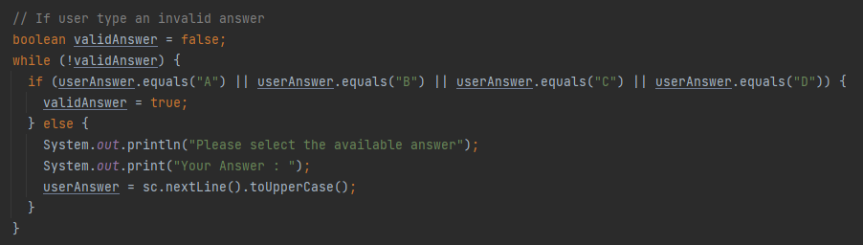
8. Steps from Coding to Execution
Coding the program After defining and planning the problem is done, we can now start to code the program according to the plan. - Taking user input using Scanner - Reading the CSV file using FileReader - Validate user input so they type correct input

Slide 13

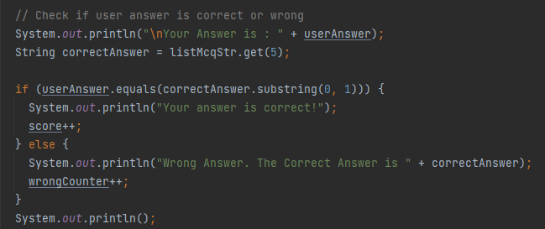
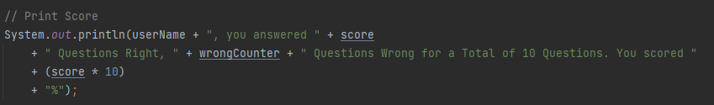
8. Steps from Coding to Execution
Checking user answer are correct or wrong and calculating user Score

Slide 14
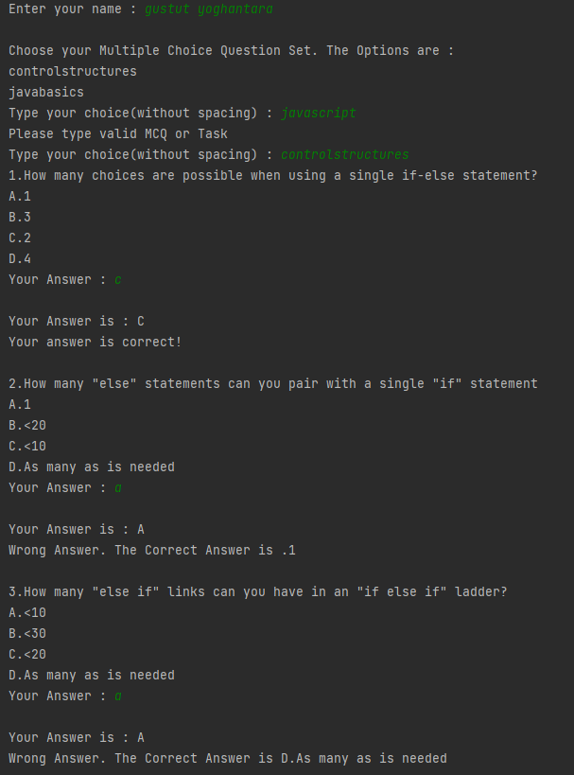
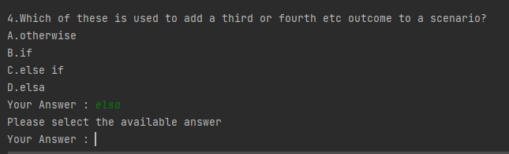
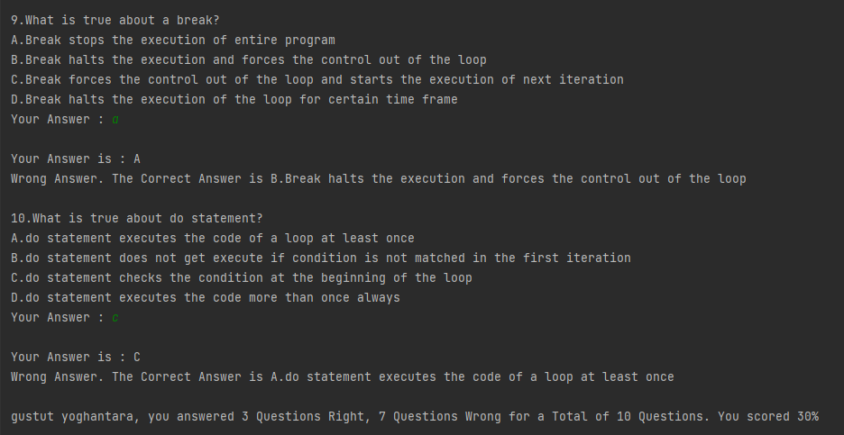
8. Steps from Coding to Execution
Executing the program

Slide 15
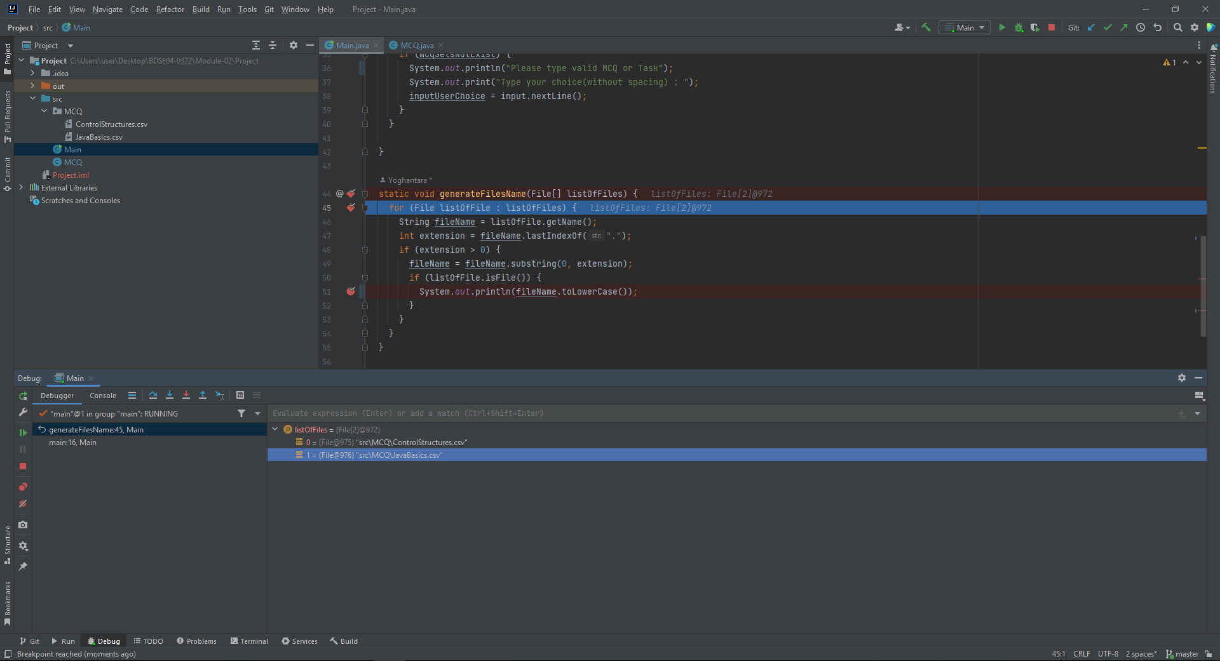
9. Development Process
Debugging Mode

Slide 16


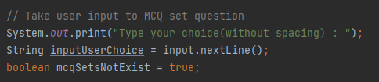
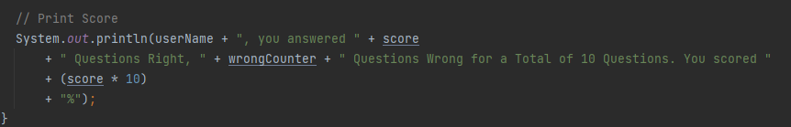
10. Coding Standard
Using camel case for naming method or variable
Commenting line
Indentation

Slide 17
11. Milestone Feedback & Action taken
Project Milestone ID | Milestone Feedback received from Tutor / Learning Facilitator | Action Taken (Yes / No)
1 | Revise project result screenshot, list evidences & add project deliverables | Yes
2 | Creating the project presentation according to the template given | Yes

Slide 18
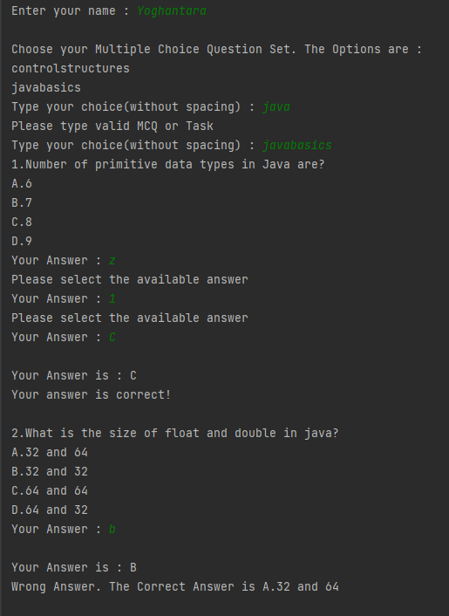
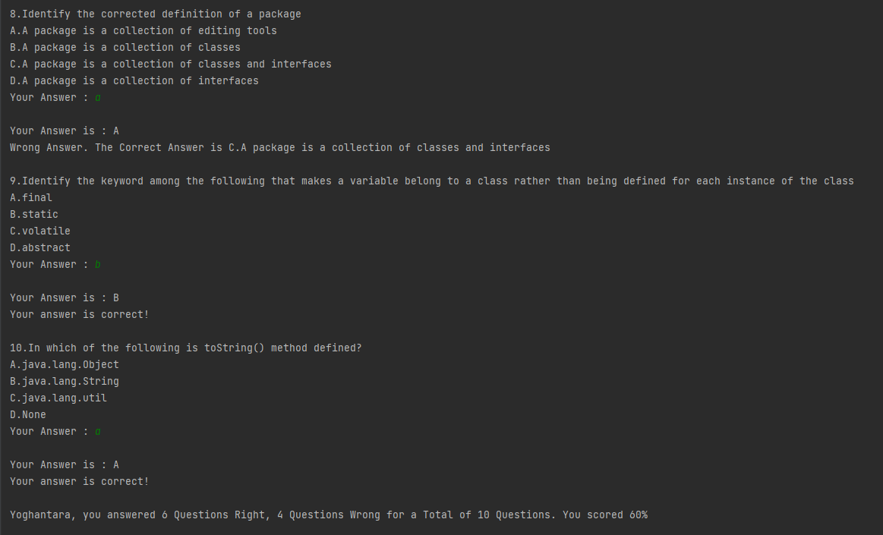
12. Project Results
Screen Shots of Evidences

Slide 19
13. Proposed Improvements
List of Improvements
Making private instance variable in class to restrict visibility, and can be accessed only when created the getter setter method.
Separated the method to do only one task
Using more OOP Concept to create a robust application

